Slide 1
Parallel Computing
Youssef Wally
SISD
SIMD
MISD
MIMD
youssef.m.wally@uit.no

Slide 2
CPU vs GPU — Know Your Hardware
Foundations
CPU
GPU
Core 1
Core 2
Core 3
Core 4
L3 Cache
CPU
GPU
4–64 powerful cores
Large cache + branch prediction
1000s of small cores
Optimised for massively parallel tasks
Optimised for serial,
complex tasks
OS, logic, I/O, general programs
Built to render millions
of pixels at once
ML training, images, matrix math, sims

Slide 3
Flynn's Taxonomy (1966)
Overview
Every computing system can be classified by how it handles Instructions and Data streams
SISD
Single Instruction
Single Data
SIMD
Single Instruction
Multiple Data
One processor, one data stream.
Traditional sequential programs.
Same op applied to many data.
GPUs, AVX vector intrinsics.
e.g. Your Python for-loop
e.g. GPUs
MISD
Multiple Instruction
Single Data
MIMD
Multiple Instruction
Multiple Data
Different ops, same data.
Rare — fault-tolerant pipelines.
Many processors, many data.
Most modern parallel systems.
e.g. OpenMP, MPI, multiprocessing

Slide 4
SISD — Sequential Processing
SISD
Python — SISD
①
One CPU core does all the work
# Single Instruction, Single Data
def process_img(image, data):
# ... your logic here ...
# SISD loop: one sample at a time
for sample in samples:
image, data = sample
process_img(image, data)
②
Samples processed one at a time
③
process_img() blocks until done
④
Throughput: 1× — the baseline
⏱ Execution Timeline:
sample[0]
sample[1]
sample[2]
sample[3]
...

Slide 5
SIMD & MISD — A Quick Look
Not Today's Focus
SIMD
Single Instruction, Multiple Data
MISD
Multiple Instruction, Single Data
The same operation is applied to many
data elements simultaneously — in hardware.
Different operations run on the same
data — mostly theoretical / safety-critical.
Python — SIMD (NumPy)
▸ Fault-tolerant flight computers
# NumPy uses SIMD under the hood
# (AVX/SSE CPU vector instructions)
import numpy as np
pixels = np.array(image)
bright = pixels * 1.2
▸ Space Shuttle: 5 computers running
different code on the same sensor data
▸ Rarely seen in everyday software
➜ For the rest of this tutorial, we focus on MIMD

Slide 6
MIMD — Divide & Conquer
MIMD
Split the samples list across workers — each independently runs process_img()
samples
Worker 0
process_img()
3 Ways to Implement MIMD:
s[0], s[4]
Python
s[0]
s[1]
multiprocessing.Pool — separate OS processes
s[2]
Worker 1
process_img()
s[3]
s[1], s[5]
s[4]
C++
s[5]
OpenMP — shared memory, same machine
Worker 2
process_img()
s[6]
s[7]
s[2], s[6]
C++
Worker 3
process_img()
MPI — distributed memory, many machines
s[3], s[7]

Slide 7
MIMD — Python Multiprocessing
MIMD
Bypasses the GIL by spawning separate OS processes — each with its own memory space
Python — multiprocessing.Pool
Why not threading?
from multiprocessing import Pool
def process_img(image, data):
# ... your logic here ...
def process_sample(sample):
# Each worker process calls this
image, data = sample
return process_img(image, data)
# Spawn one process per CPU core
with Pool(processes=8) as pool:
results = pool.map(process_sample, samples)
# pool.map() blocks until ALL samples done
# then returns results in order
Python's GIL (Global Interpreter Lock) prevents true parallel execution of Python threads. Multiprocessing sidesteps this by using separate processes.
pool.map()
Automatically distributes list items across workers and collects results. Equivalent to a parallel for-loop.
Overhead warning
Process startup has cost. Only faster than sequential when each task takes significant time (e.g. image processing ✓).
Memory Model: Each process has its own copy of samples

Slide 8
MIMD — C++ Sequential → OpenMP
MIMD
One pragma line transforms a sequential loop into a parallel one
C++ — Sequential
C++ — OpenMP
// C++ — Sequential (SISD baseline)
void process_img(Image& img, Data& data) {
// ... your logic here ...
}
for (auto& sample : samples) {
process_img(sample.image, sample.data);
}
// Compile: g++ -O2 -o app main.cpp
// C++ — OpenMP (MIMD, shared memory)
void process_img(Image& img, Data& data) {
// ... your logic here ...
}
// ↓ This ONE line parallelises the loop
#pragma omp parallel for schedule(dynamic)
for (int i=0; i<samples.size(); i++) {
process_img(samples[i].image, samples[i].data);
}
// Compile: g++ -O2 -fopenmp -o app main.cpp
// Threads: OMP_NUM_THREADS=8 ./app
➜

Slide 9
MIMD — C++ with MPI
MIMD
Unlike OpenMP, MPI processes run on SEPARATE MACHINES — each rank has its own memory
C++ — MPI
OpenMP vs MPI
#include <mpi.h>
int main(int argc, char** argv) {
MPI_Init(&argc, &argv);
int rank, size;
MPI_Comm_rank(MPI_COMM_WORLD, &rank); //process’s ID
MPI_Comm_size(MPI_COMM_WORLD, &size); //processes
// Each rank handles its own chunk
for (int i=rank; i<samples.size(); i+=size) {
process_img(samples[i].image, samples[i].data);
}
// Gather results to rank 0
MPI_Gather(local, n, MPI_FLOAT, all, n,
MPI_FLOAT, 0, MPI_COMM_WORLD);
MPI_Finalize();
}
Property
OpenMP
MPI
Memory
Shared
Distributed
Scope
One machine
Many machines
Setup
#pragma
MPI_Init/Comm
Scale
~100 cores
100k+ cores
Data pass
Automatic
Explicit send
Use case
Workstation
HPC cluster
$ mpic++ -O2 -o app main.cpp $ mpirun -np 32 ./app

Slide 10
Summary — Which Tool, When?
Python (sequential)
SISD
Baseline. Simple, debuggable.
Python (multiprocessing)
MIMD
Easy win. Limited by process overhead & GIL.
C++ (sequential)
SISD
Compiled speed. No parallelism needed.
C++ + OpenMP
MIMD
Best single-machine throughput.
C++ + MPI
MIMD
HPC clusters. Scales to any size.

Slide 11
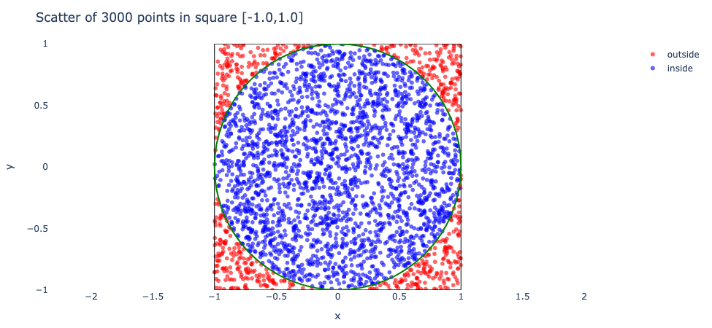



Hands-On Example
Estimation of Pi
The idea is to simulate random (x, y) points in a 2-D plane with domain as a square of side 2r units centered on (0,0)
$$\frac{\text{area} \text{of} \text{the} \text{circle}}{\text{area} \text{of} \text{the} \text{square}} = \frac{πr^{2}}{4r^{2}} = \frac{π}{4}$$
$$\sim π=4 * \frac{points generated inside the circle}{points generated inside the square}$$

